Slide 1
Complex Research Design
Experimental Psychology

Slide 2
Complex research designs
Can involve
Multiple independent variables
Multiple dependent variables
Complex correlational designs

Slide 3
Multiple dependent variables
Measures of different constructs
Measures of the same construct

Slide 4
Measures of different constructs
Allows the researcher to address more research questions in a single study
E.g., What is the effect of music therapy on language development and confidence in language-use among children with language delays?

Slide 5
Measures of the same construct
Multiple measures of the same construct
E.g., multiple measures of stress
Can be analyzed separately
Or can be combined to produce single measure of that construct
Must have strong internal consistency reliability

Slide 6
Examples of multiple dependent variables
Imagine a study in which the independent variable is whether the room where participants are tested is warm (80 degrees) or cool (65 degrees). List three dependent variables that you might treat as measures of separate constructs. List three more that you might combine and treat as measures of the same underlying construct. (Price, 2012. p. 117)

Slide 7
Measuring multiple independent variables
Type of research in which multiple IVs are measured
E.g., What is the effect of mood and level of anxiety on driving performance among race car drivers?
Also can address more research questions in one study
Most common type is a factorial design

Slide 8
Factorial designs
Factorial designs- A study with multiple independent variables
Independent variable = Factor
Each level of IV is combined with each level of the other IVs to produce all possible combinations
Can also address questions about whether the effect of one IV depends on the level of another
E.g., Is driving performance affected by time of day and cell phone use?
IV: Time of day and cell phone use (2 IVs)
DV: Driving performance

Slide 9
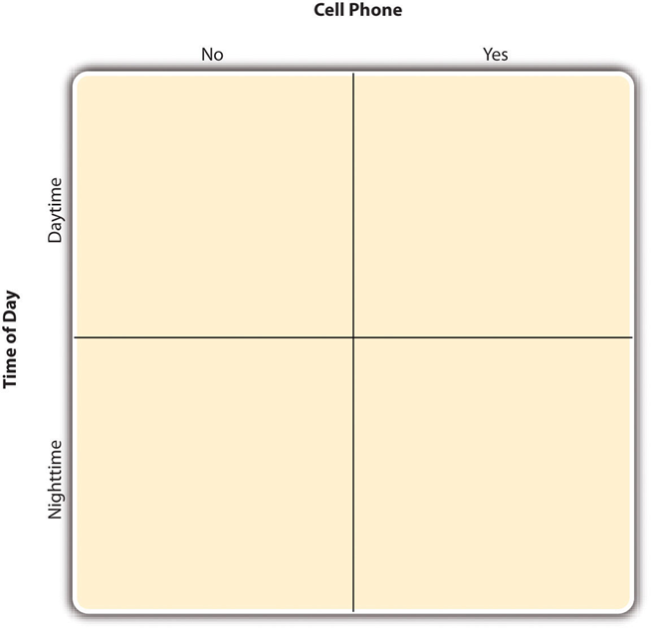
Factorial design table (2x2 design)
2 IVs:
Cell phone use
Has two levels:
Yes
No
Time of day
Has two levels:
Daytime
Nighttime

Slide 10
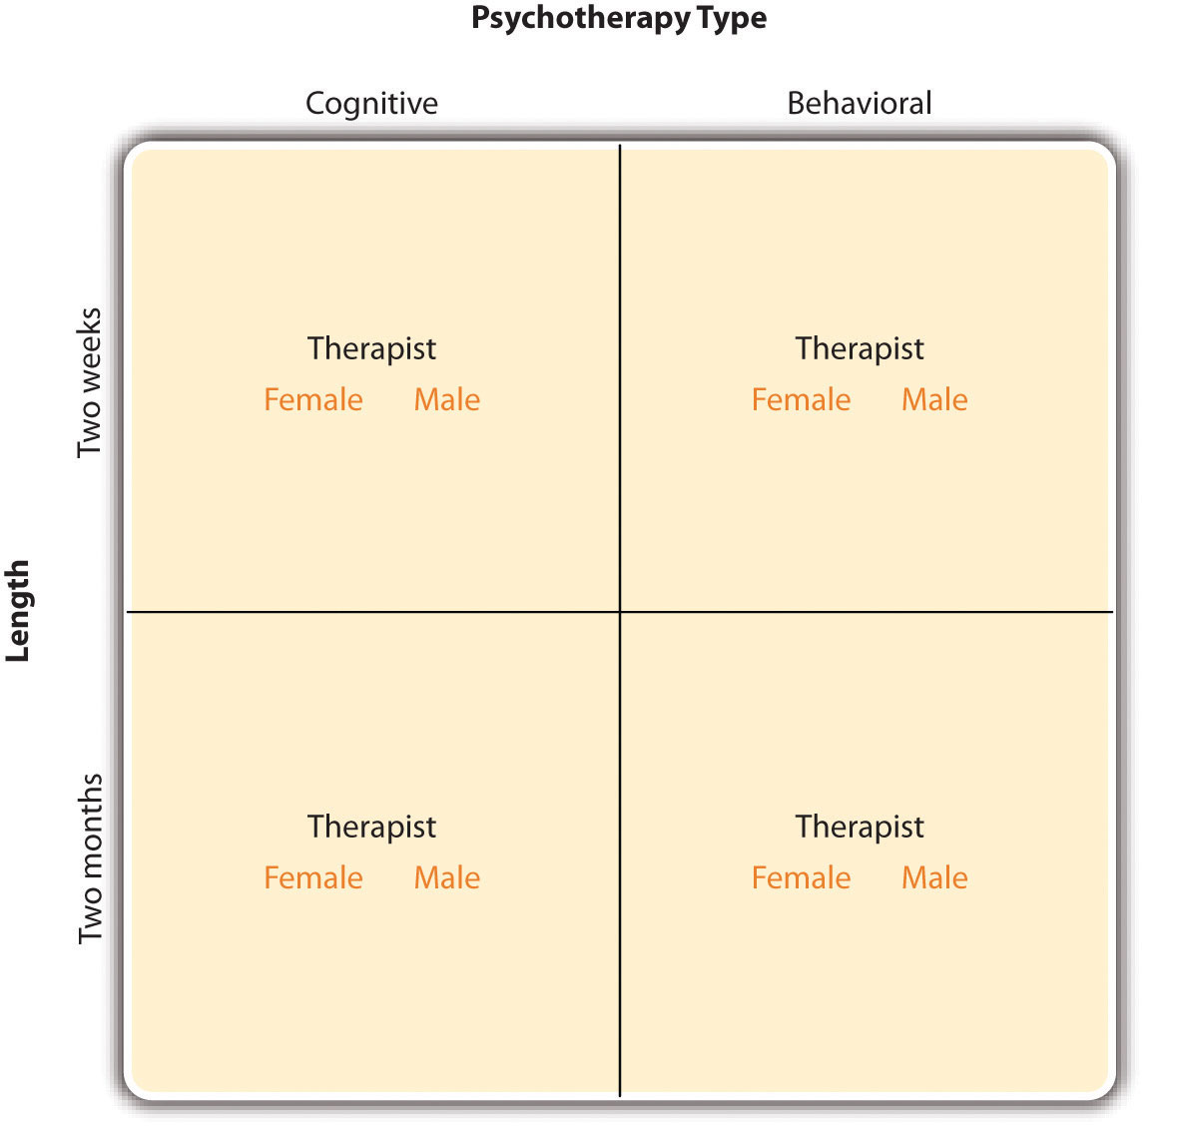
Factorial design table (2x2x2 design)

Slide 11
Your turn
Come up with a research question for a factorial design that involves more than one IV.
What are your IVs?
What is your DV?
How many levels do the IVs have? What are the levels?

Slide 12
Main effects and interactions
Main effect: The effect of one independent variable averaged across levels of all other independent variables
Main effects are independent of each other
E.g., Is there an effect of time of day on driving performance?
E.g., Is there an effect of cell phone use on driving performance?

Slide 13
Interactions between variables
Effects involving the combination of variables are called interactions.
If predicting an effect of one variable requires that you know the value of the other variable, there may be an interaction.
E.g., Is driving performance affected by time of day and cell phone use together?

Slide 14
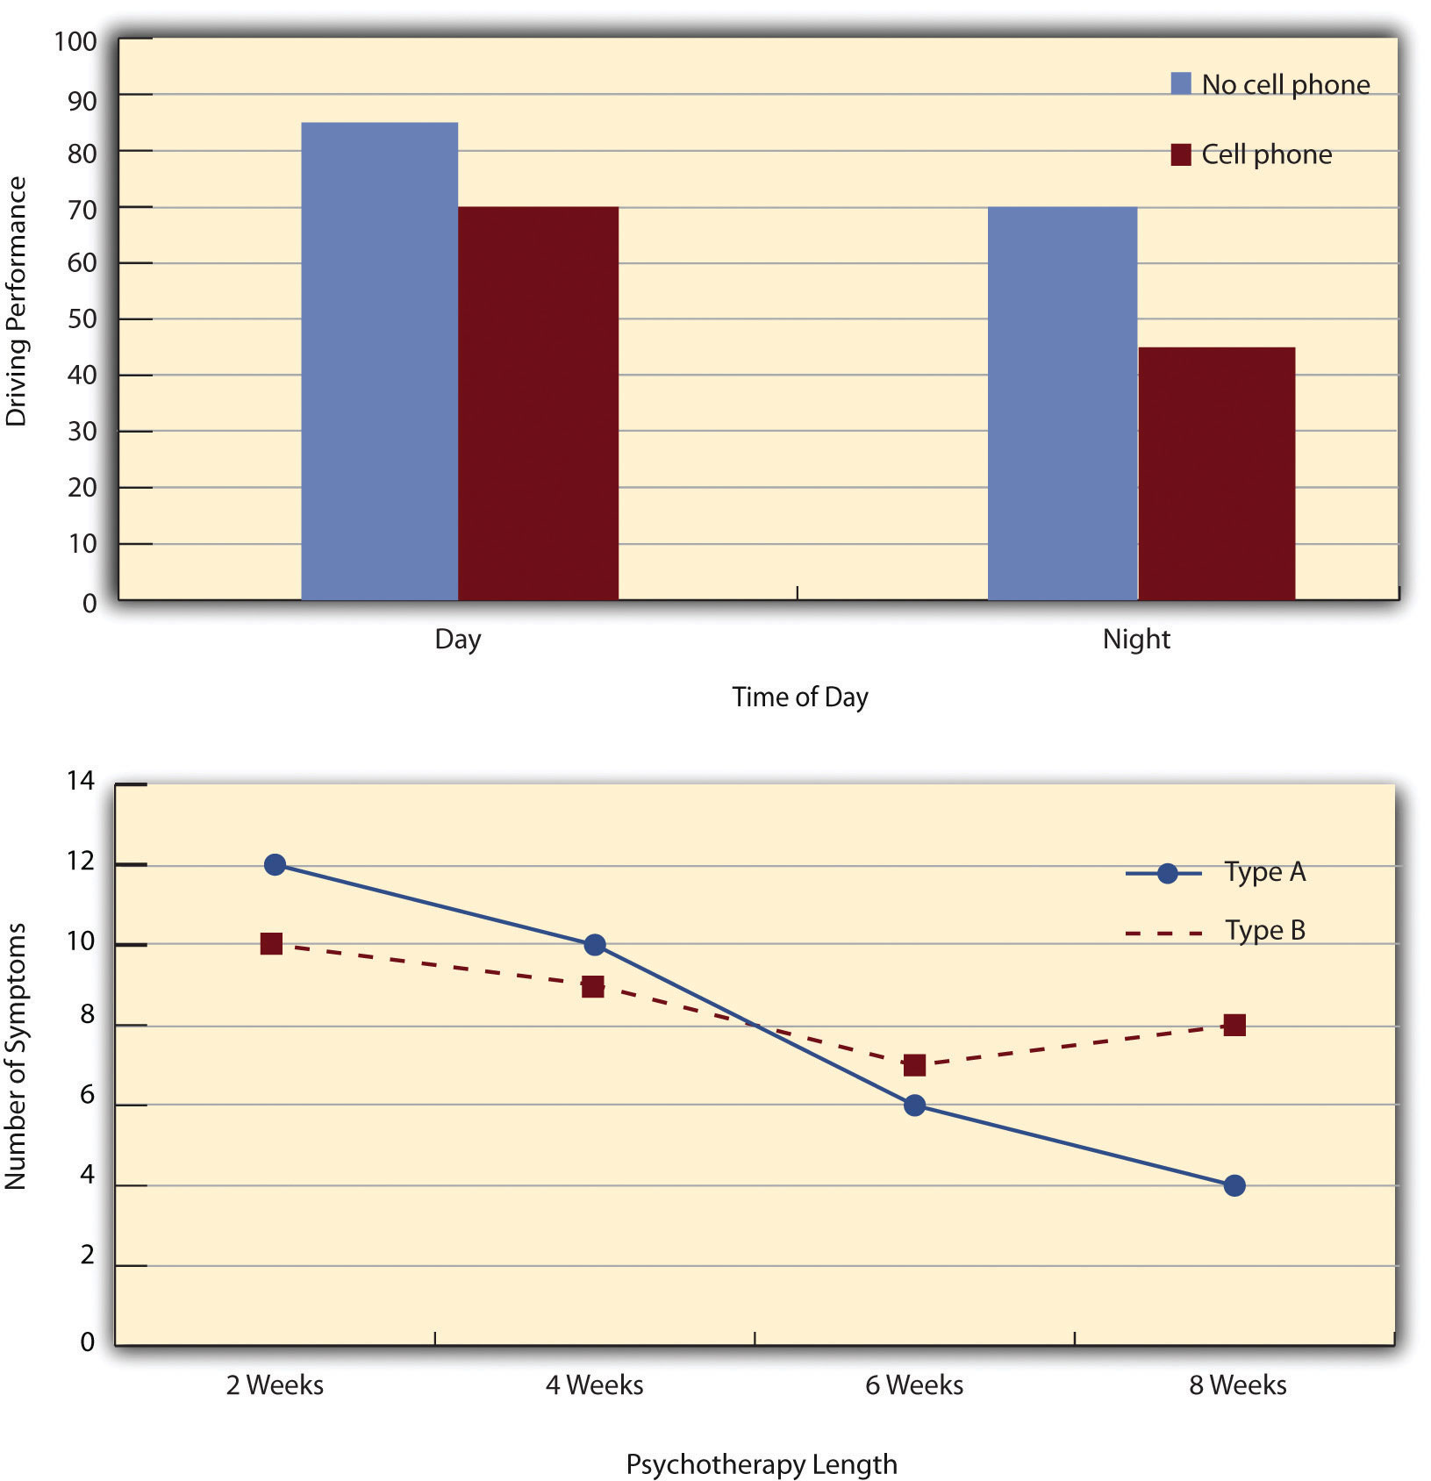
Ways to plot factorial design results: Two independent variables

Slide 15
Designing a factorial design study
Go back to your 2x2 factorial design study.
How would you know there was an interaction?
How would you know if there were any main effects?

Slide 16
Data analysis
The Analysis of Variance (ANOVA) is the typical statistic for factorial designs.

Slide 17
Multiple regression

Slide 18
Multiple regression
Can look at multiple factors at once
Regression analyses determine which factors are
Most important
Beta weight, β
Can add factors in one at a time
To see which factors account for the most variance

Slide 19
Multiple Linear Regression: Making Predictions
Linear regression- Predictor variable predicts the value of a criterion variable.
Y = a + bX
Y = value of the criterion variable (dependent variable)
a = constant (the Y-intercept)- (value of Y when X is 0)
b = slope of the line (weight)
X = value of the predictor variable

Slide 20
Your turn
Say you are interested in prison recidivism
What are some factors/tests you might use in predicting recidivism?

